Slide 1
Identifying No-Show Patterns in Healthcare
Lauren-Ashley Rutland
Natalie Lopez
Artem Zalivchiy
Eduardo Mestre

Slide 2
Table of contents
01
02
03
04
05
Data Cleaning
Data Model Implementation
Tableau Visualizations
Data Model Optimization
Conclusion

Slide 3
Purpose
The aim of our project is to uncover patterns related to patient no-shows in Colorado. We plan to utilize information such as age, chronic diseases, socio-economic factors, and geographical influences to help identify any relationships between such factors.

Slide 4
01
Data Cleaning

Slide 5
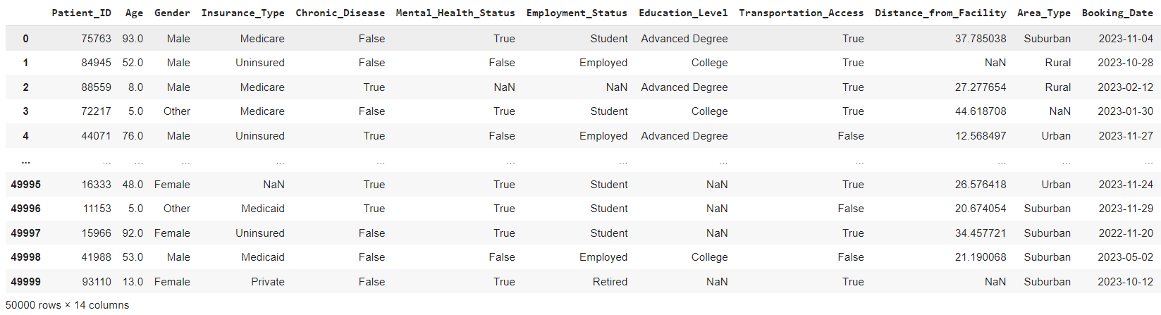
Data Cleaning
Raw dataset obtained from Kaggle.com
Loaded data into a Pandas DataFrame from a CSV file

Slide 6
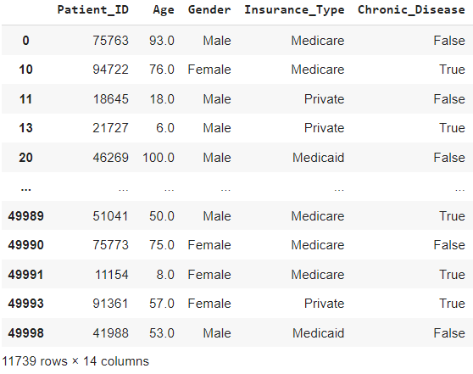
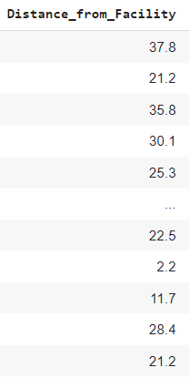
Data Cleaning
Removed Rows that contained Null Values
Round the “Distance_from_Facility” to one decimal place

Slide 7
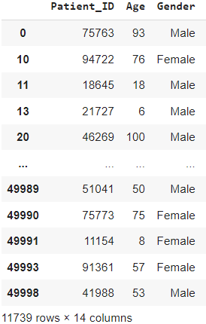
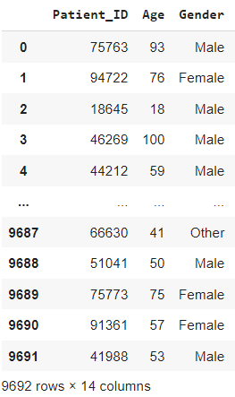
Data Cleaning
Change “Age” data to whole decimal places
Filter “Age” equal to or greater than 18

Slide 8
02
Data Model Implementation

Slide 9
Data Preprocessing:
Removed columns with high correlation.
Using cumulative distribution to find cutoff values to identify and replace infrequent categories, “Booking_Date” and “Distance_From_Facility”.
Ensure the target column Appointment_Outcome is correctly identified and processed.

Slide 10
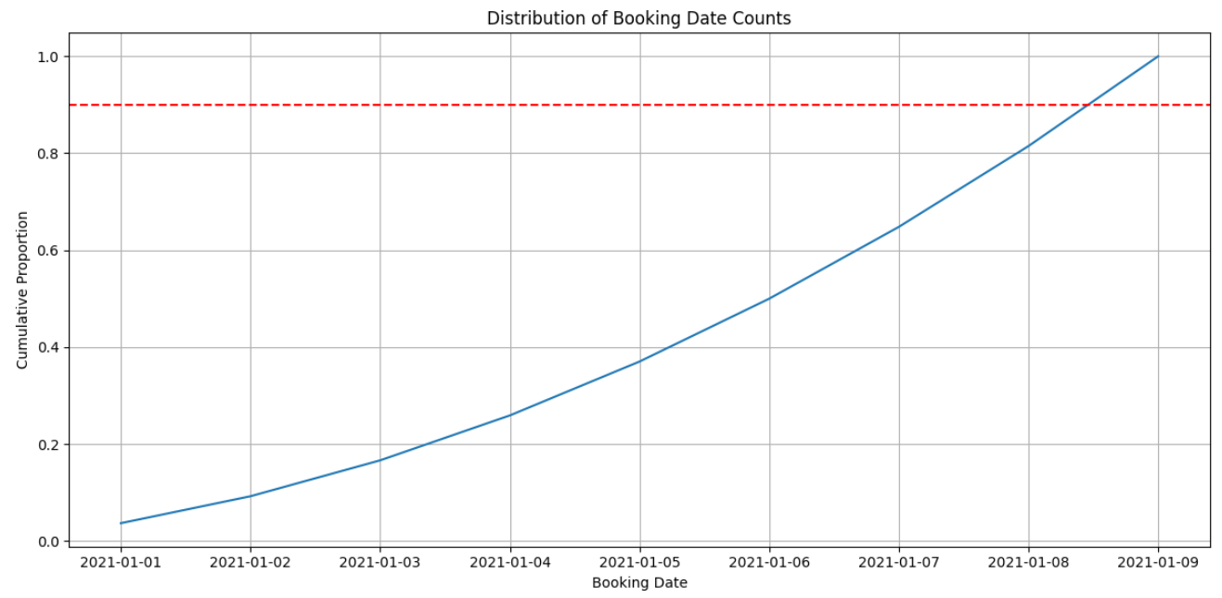
Cumulative Distribution Visualizations
90% Cumulative Proportion
Cutoff value = 450

Slide 11
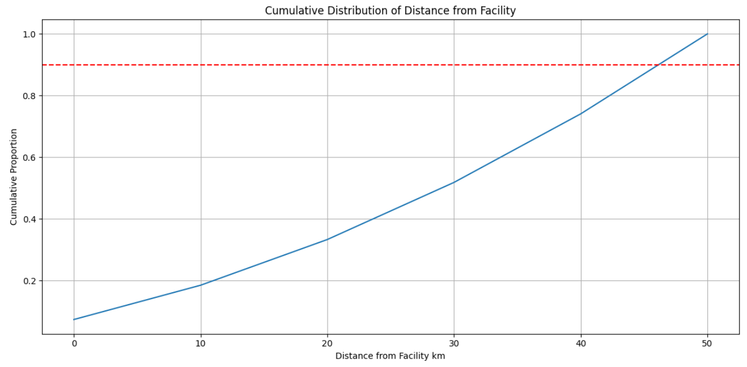
Cumulative Distribution Visualizations
90% Cumulative Proportion
Cutoff Value = 300

Slide 12
Splitting Data & Scaling:
Split the preprocessed data into feature arrays (X) and target arrays (Y).
Further split the data into training and testing sets using train_test_split.
Scale the feature data using StandardScaler.

Slide 13
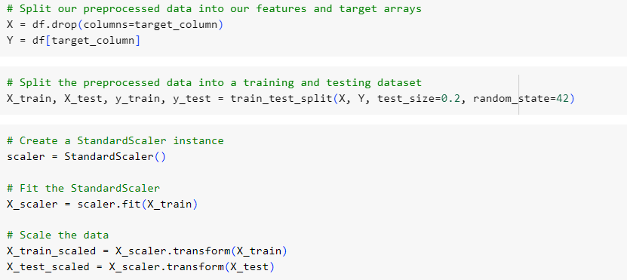
Splitting Data & Scaling Code

Slide 14
Model Definition:
Define a deep neural network model using Keras with multiple layers (input, hidden, and output layers).
Add batch normalization and dropout layers to prevent overfitting.

Slide 15
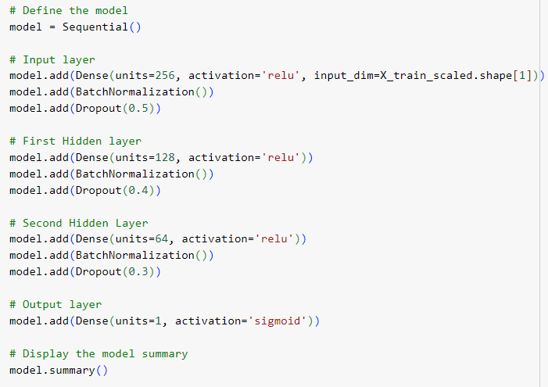
Defining the Model Code
We used a Sequential model because it allows us to build a neural network layer by layer.

Slide 16
03
Data Model Optimization

Slide 17
Model Compilation & Training:
Compile the model with the Adam optimizer and binary cross-entropy loss function.
Implement early stopping to prevent overfitting.
Train the model on the training data and validate it on the testing data.

Slide 18
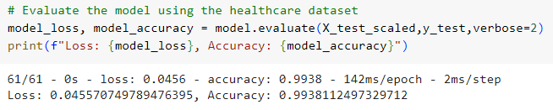
Optimizing the Model Code
Model Accuracy: 99.38%

Slide 19
04
Tableau Visualizations

Slide 20
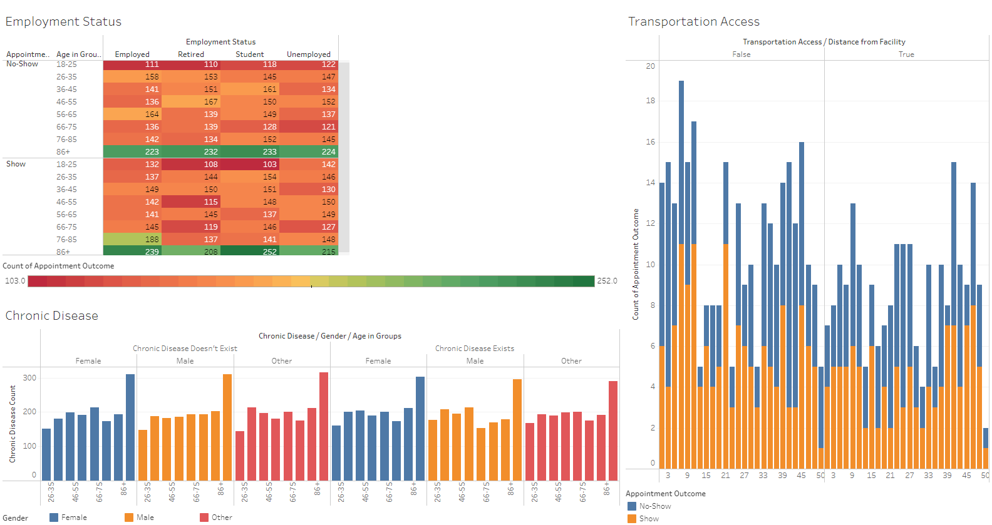
Tableau Visualizations

Slide 21
05
Conclusion

Slide 22
Conclusion
Our deep learning model achieved an accuracy of 99.38% on the healthcare dataset. We started by preprocessing the data, handling missing values, and converting categorical features to numeric using one-hot encoding. We split the data into training and testing sets and scaled the features for better performance. The neural network was built using a Sequential model with multiple dense layers, batch normalization, and dropout to prevent overfitting. The model was trained with early stopping to avoid overfitting, resulting in a highly accurate prediction of appointment outcomes.

Slide 23
Thanks!

